Slide 1
3D Food Extruder
Presented by:
Allen Tan P1831894 Cheng Ee P1820078
Vincent Ho P1824762

Slide 2
Presentation Outline
Problem
Solution
Prototype
Drawback of the system
Future Improvements

Slide 3
Project Brief
Solution for the aging population
Environmental Project
Healthcare

Slide 4

The Problem

Slide 5
“How are we going to reduce Food Wastage?”

Slide 6
Background
Notes:
As food wastage is becoming a more prevalent issues in our society. Starting from the government holding Year Towards Zero Waste campaign this year .Campaign is targeted at the food wastage in eateries and supermarket .Traditionally, bad looking food is usually thrown out but.we are going to be using it to creatie the filament of the 3D printer.This reduce food wastage and also increase the shelf life of the fruits.
Introduction
The way most people picked their fruits is by appearance.This lead to having a lot of ugly fruits wasted and this adds on to Singapore food wastage.With Technology however,there is a way to put the ugly fruits into good use.The ugly food will be dried into powder and rehydrated into paste .This will then be used for the filament of the 3D printer we are creating
Objective
The product aims to reduce the wastage of ugly fruits .This is to cope with food shortages
Scope
This product contains both hardware system and software system.The hardware is the

Slide 7
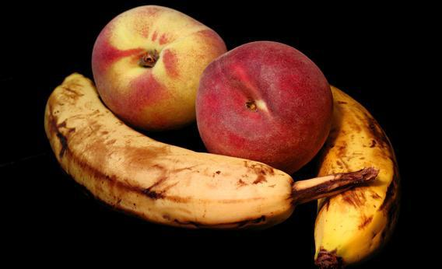
Food wastage has been a Global concern as we have limited supply and the population is going to increase .This might lead food shortage.Preserving food is a way to deal with the demand of food shortage.Traditionally,this ugly fruits are not bought and hence thrown out regardless of whether is edible or not.
Notes:
Food wastage is a big problem in Singapore.Food wasted 2017 was 809,800 tonnes.There is an increase of over 24,000 tonnes since 2015, according to statistics published on the NEA website.

Slide 8
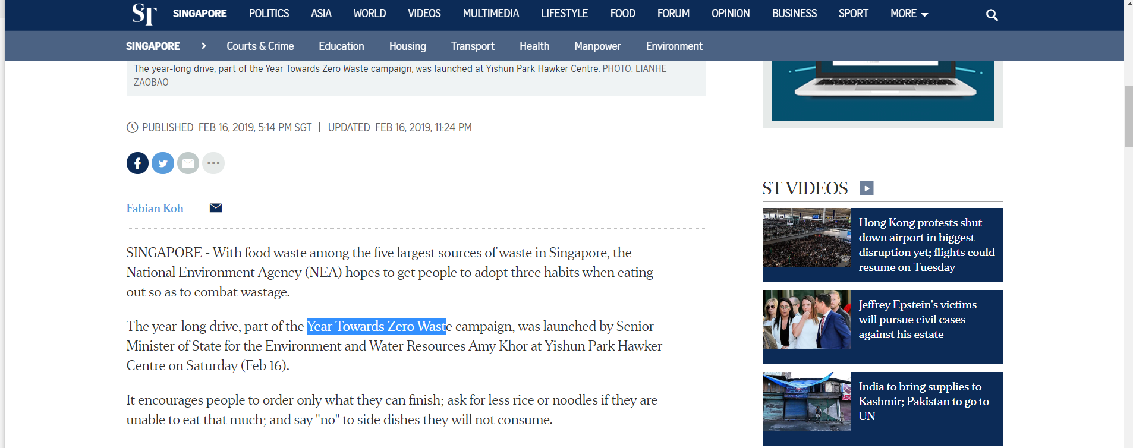
Notes:
Food wastage is a big problem in Singapore.Food wasted 2017 was 809,800 tonnes.There is an increase of over 24,000 tonnes since 2015, according to statistics published on the NEA website.

Slide 9
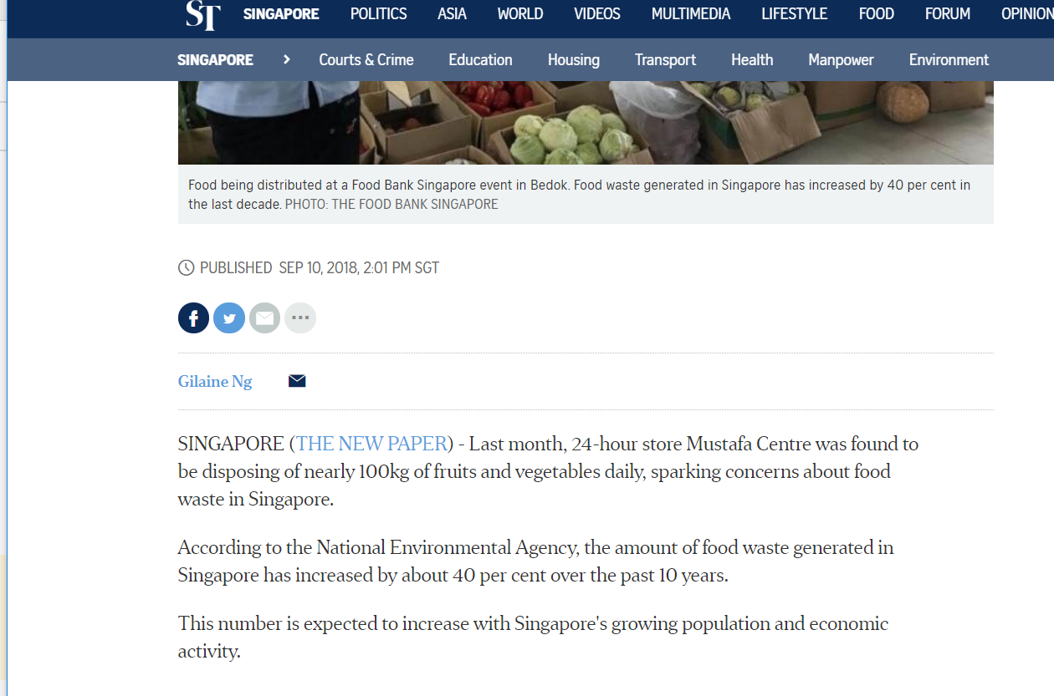

Slide 10
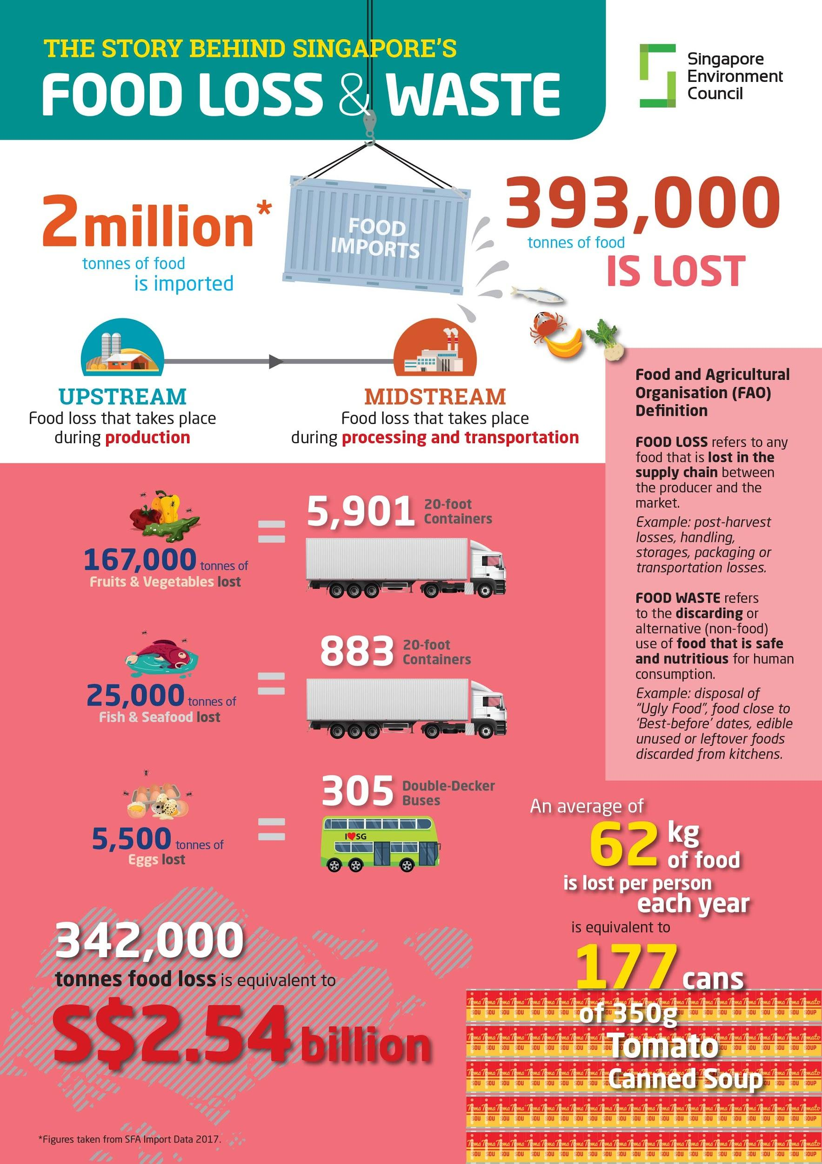
Notes:
Food waste ends up wasting water supply, food that is never eaten accounts for 25% of all freshwater consumption globally
Resources that went into creating the uneaten food wasted and when food waste goes to landfill,, it decomposes without access to oxygen and creates methane, which is 23x more deadly than carbon dioxide.

Slide 11

The Solution

Slide 12
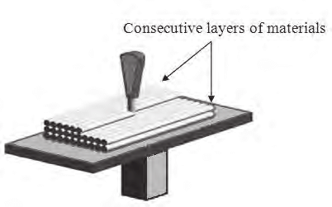
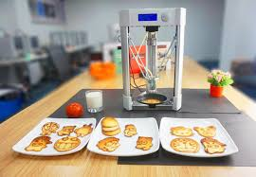
3D Printing

Slide 13
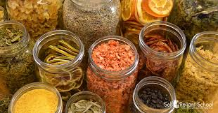
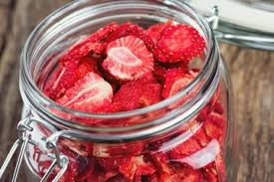
Dehydration

Slide 14
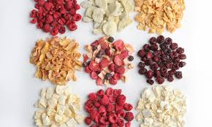
Dry-Freezing

Slide 15
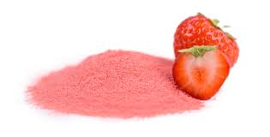
Pulverize

Slide 16
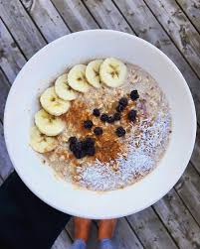

Can be used a sweet toppings

Slide 17
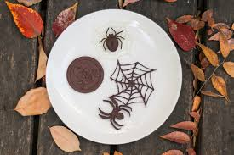
Make Something FUN!!

Slide 18
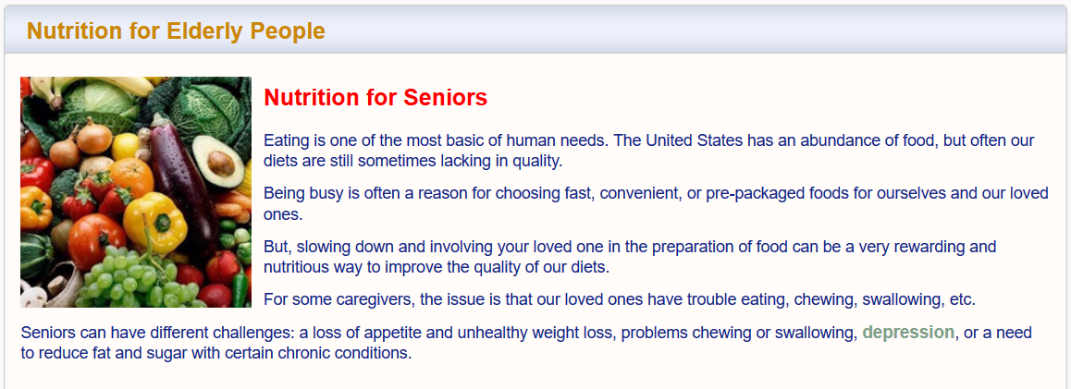

Slide 19
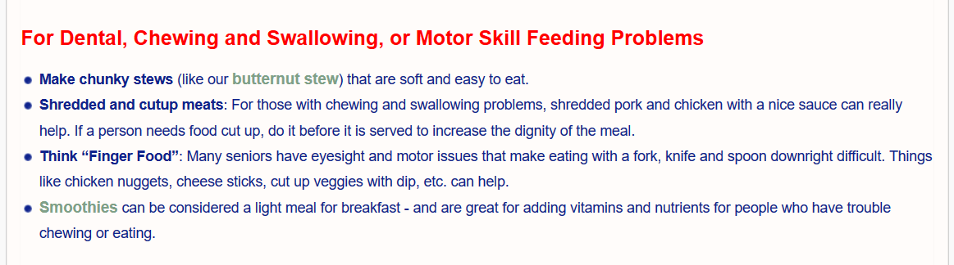

Slide 20
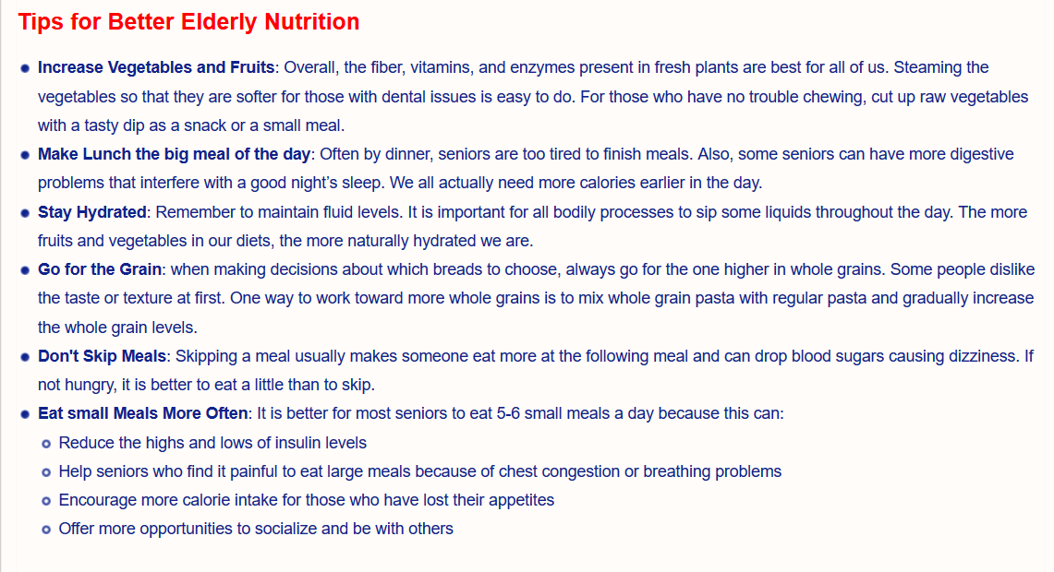

Slide 21
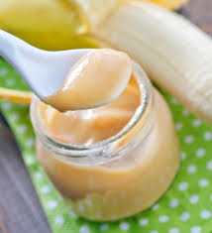
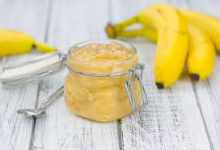
Banana Puréé

Slide 22
Prototype

Slide 23
3D Extruding Unit
+
Peltier Unit

Slide 24
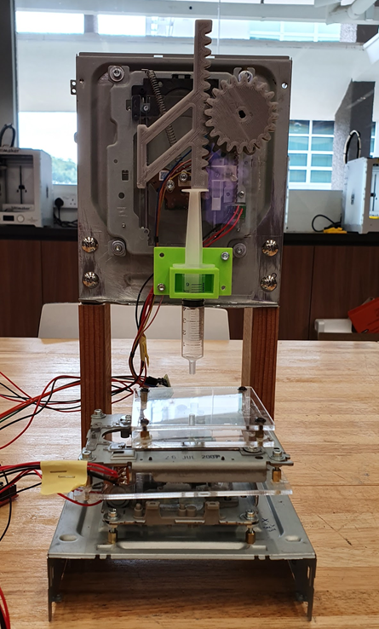
3D Extruding Unit
CD Drives
Acrylic
4 stepper motors
2 Arduino (1 master 1 slave)

Slide 25
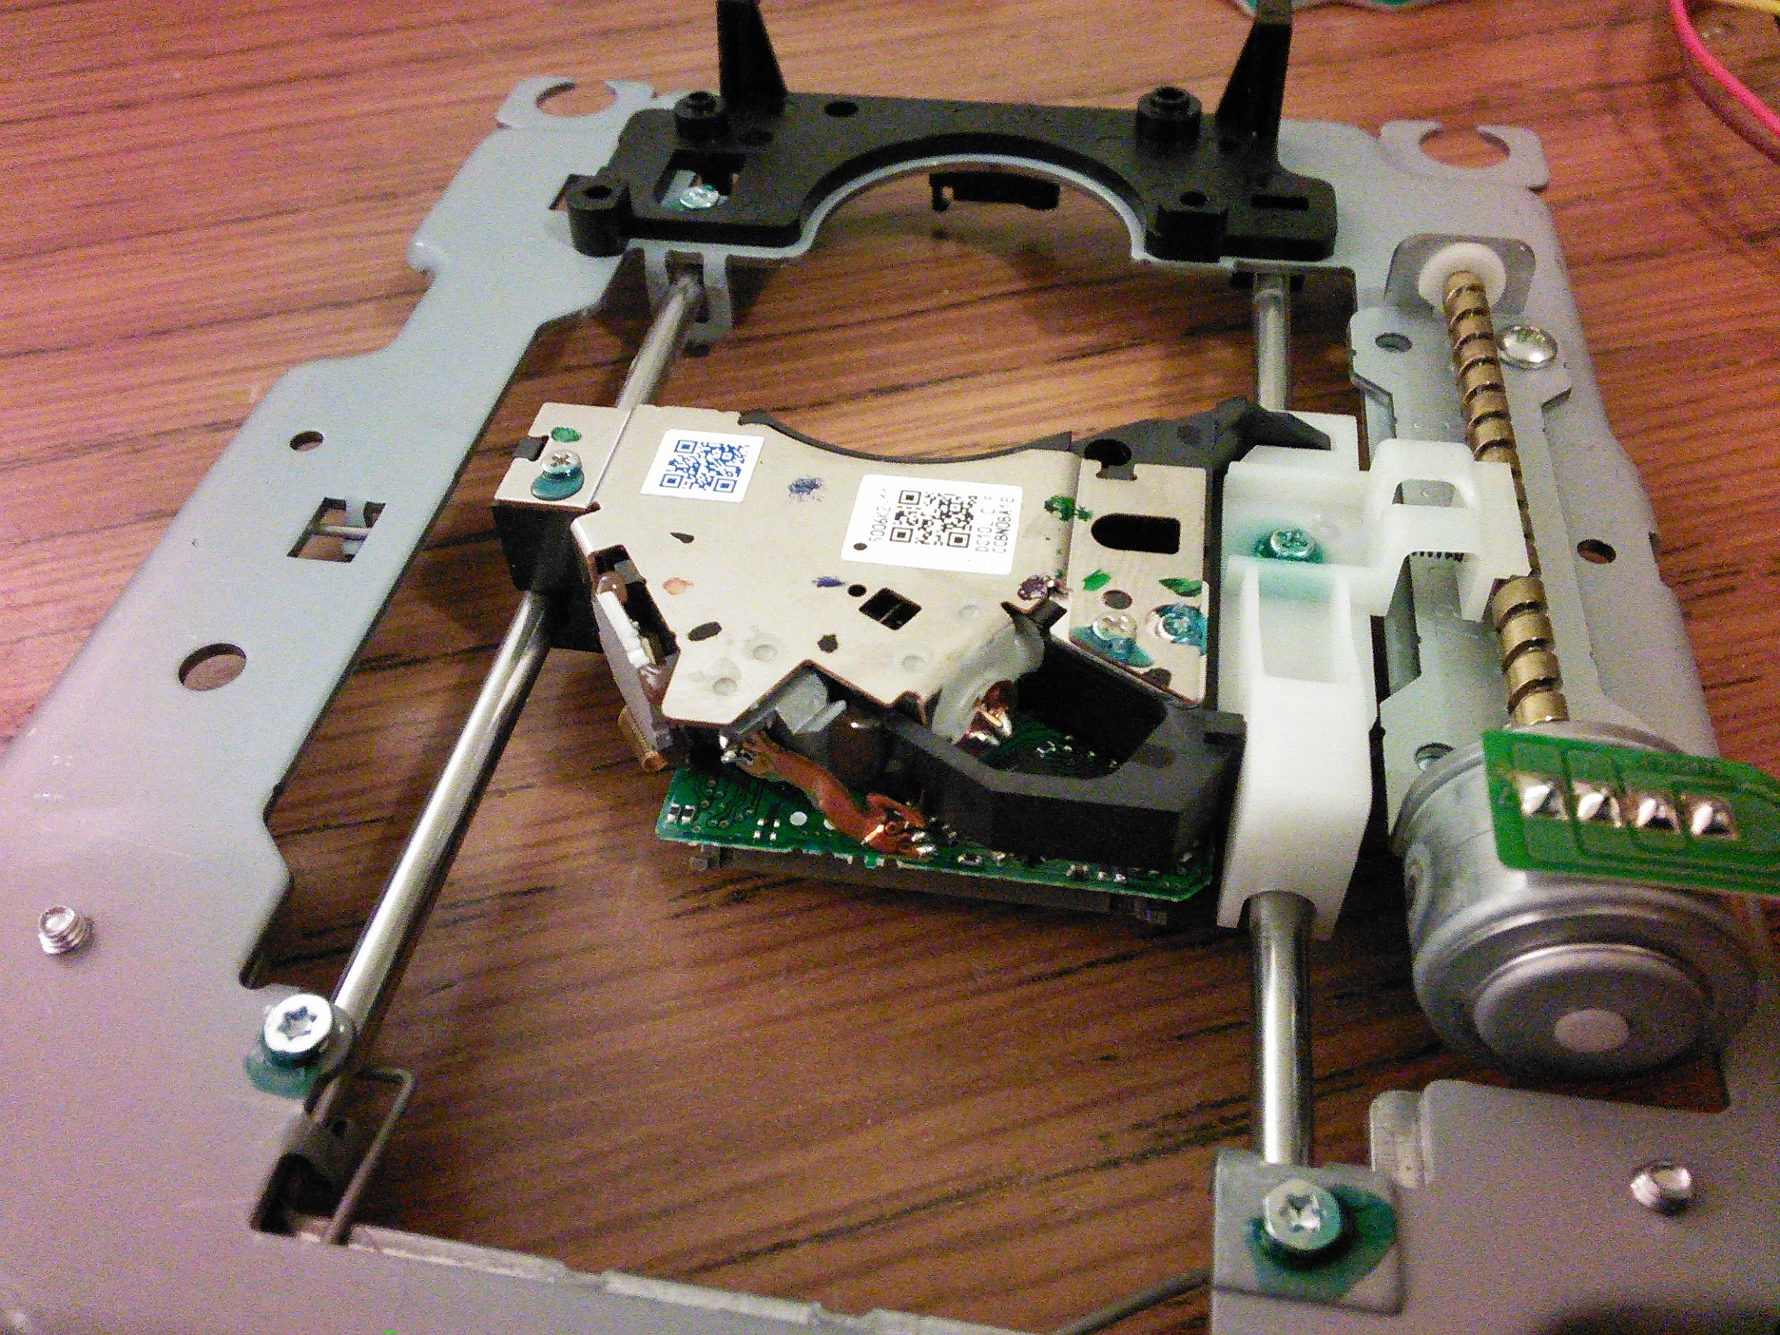
Axes made from CD drives

Slide 26
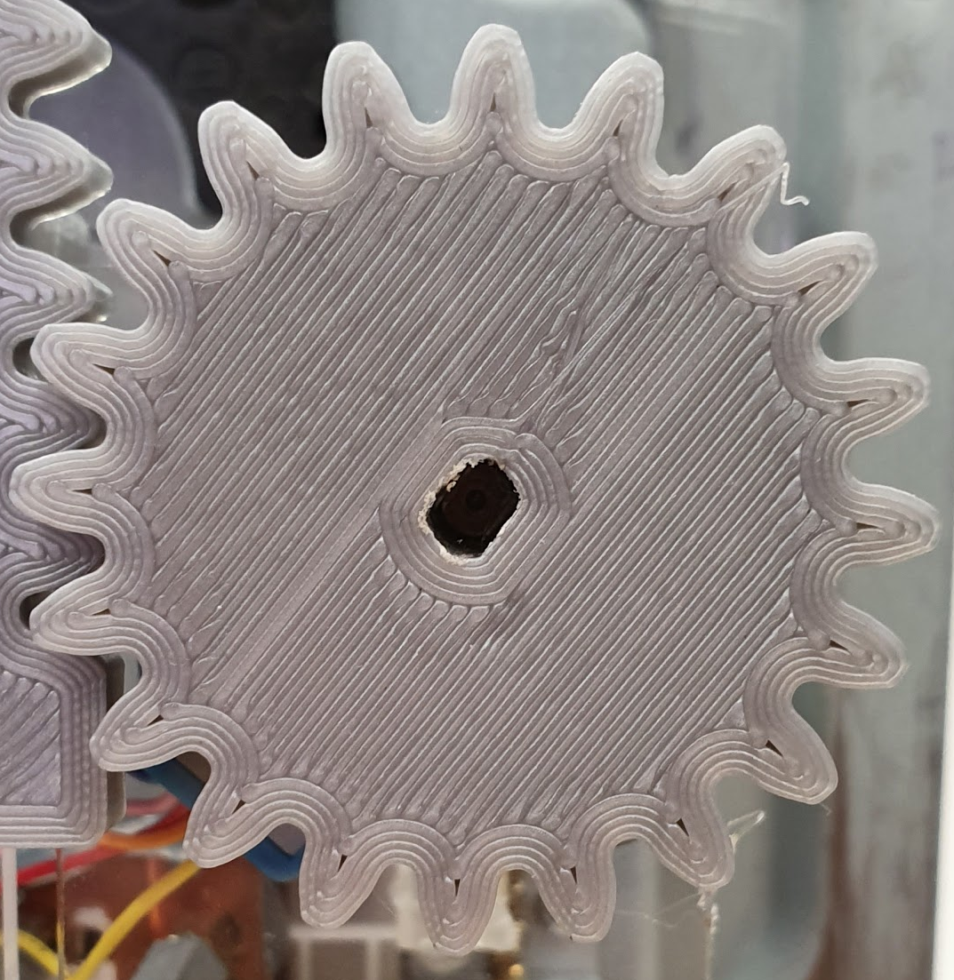
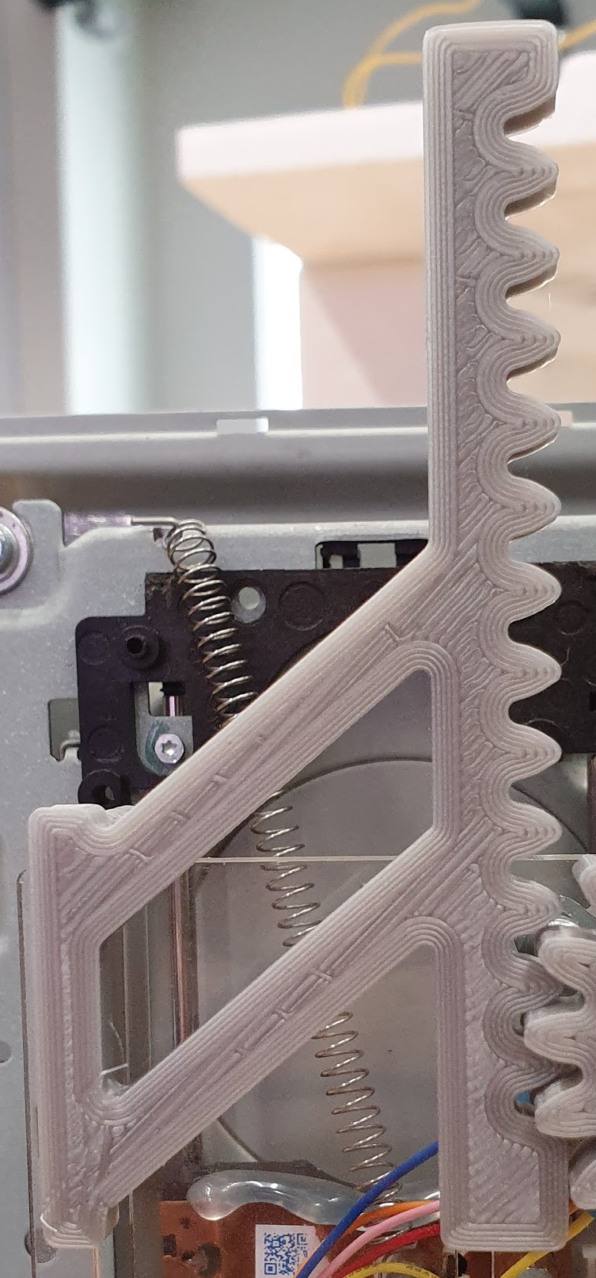
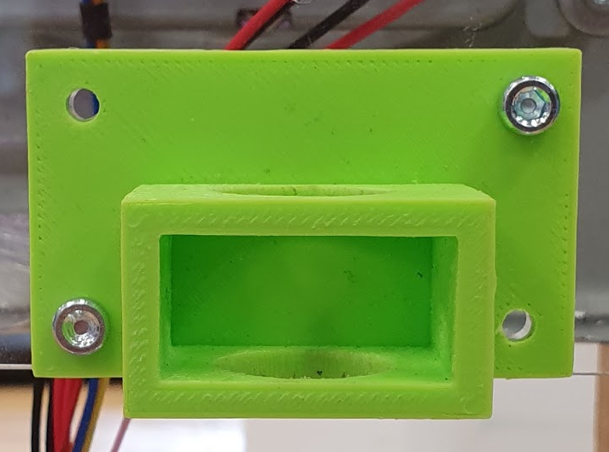
3D Printed Parts

Slide 27
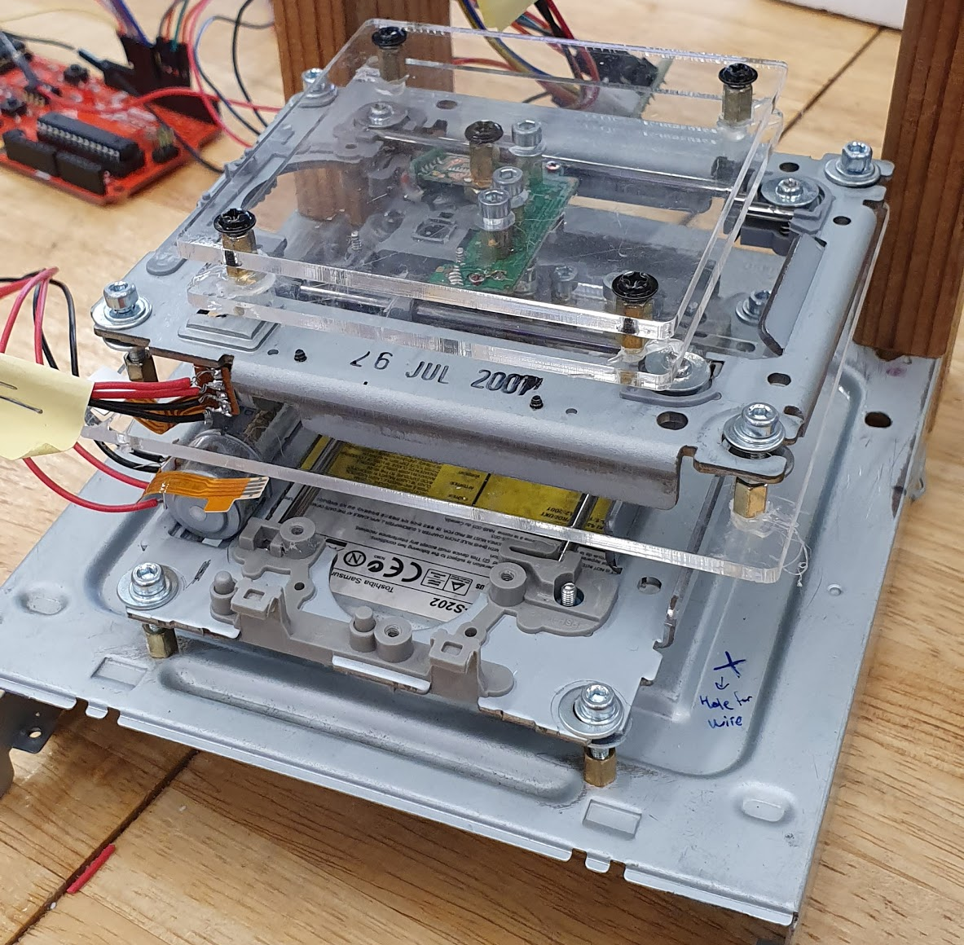
Bottom Platform - X & Y Axes

Slide 28
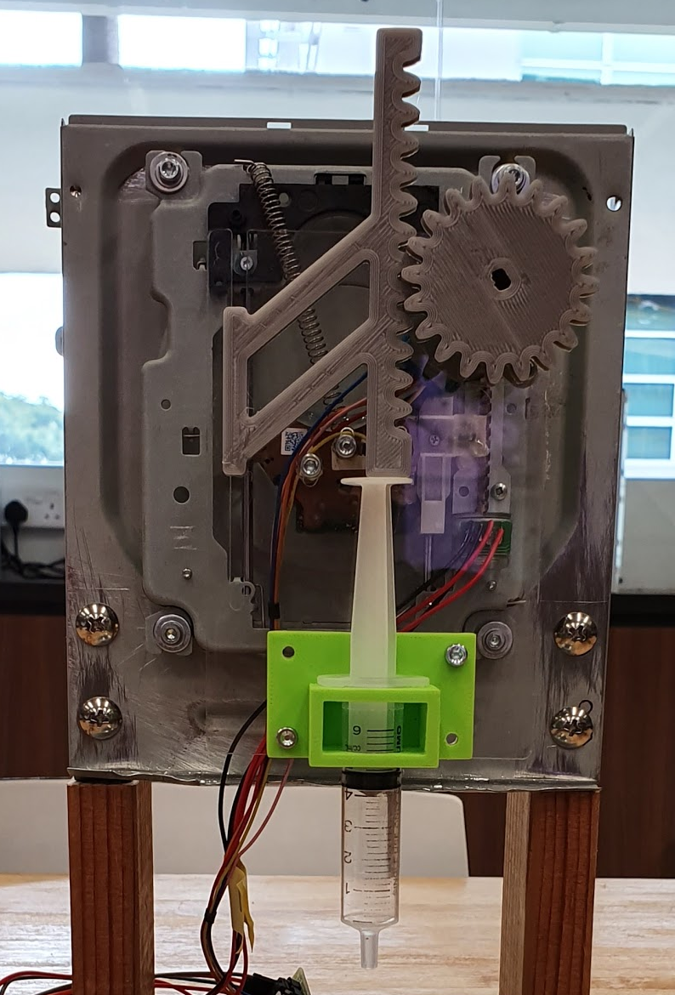
Z-axis - Extruder Head

Slide 29
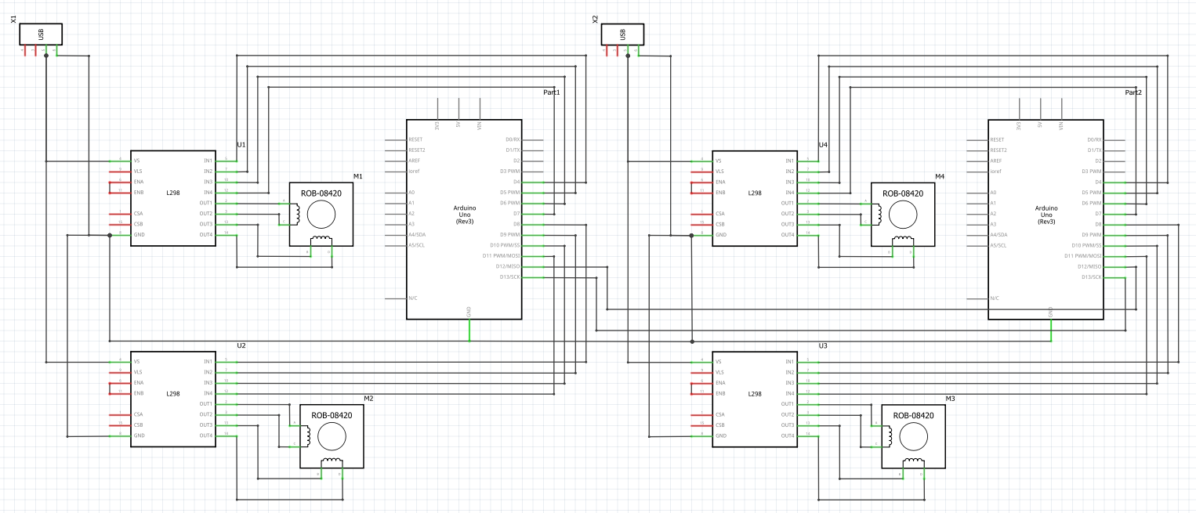
Schematics

Slide 30
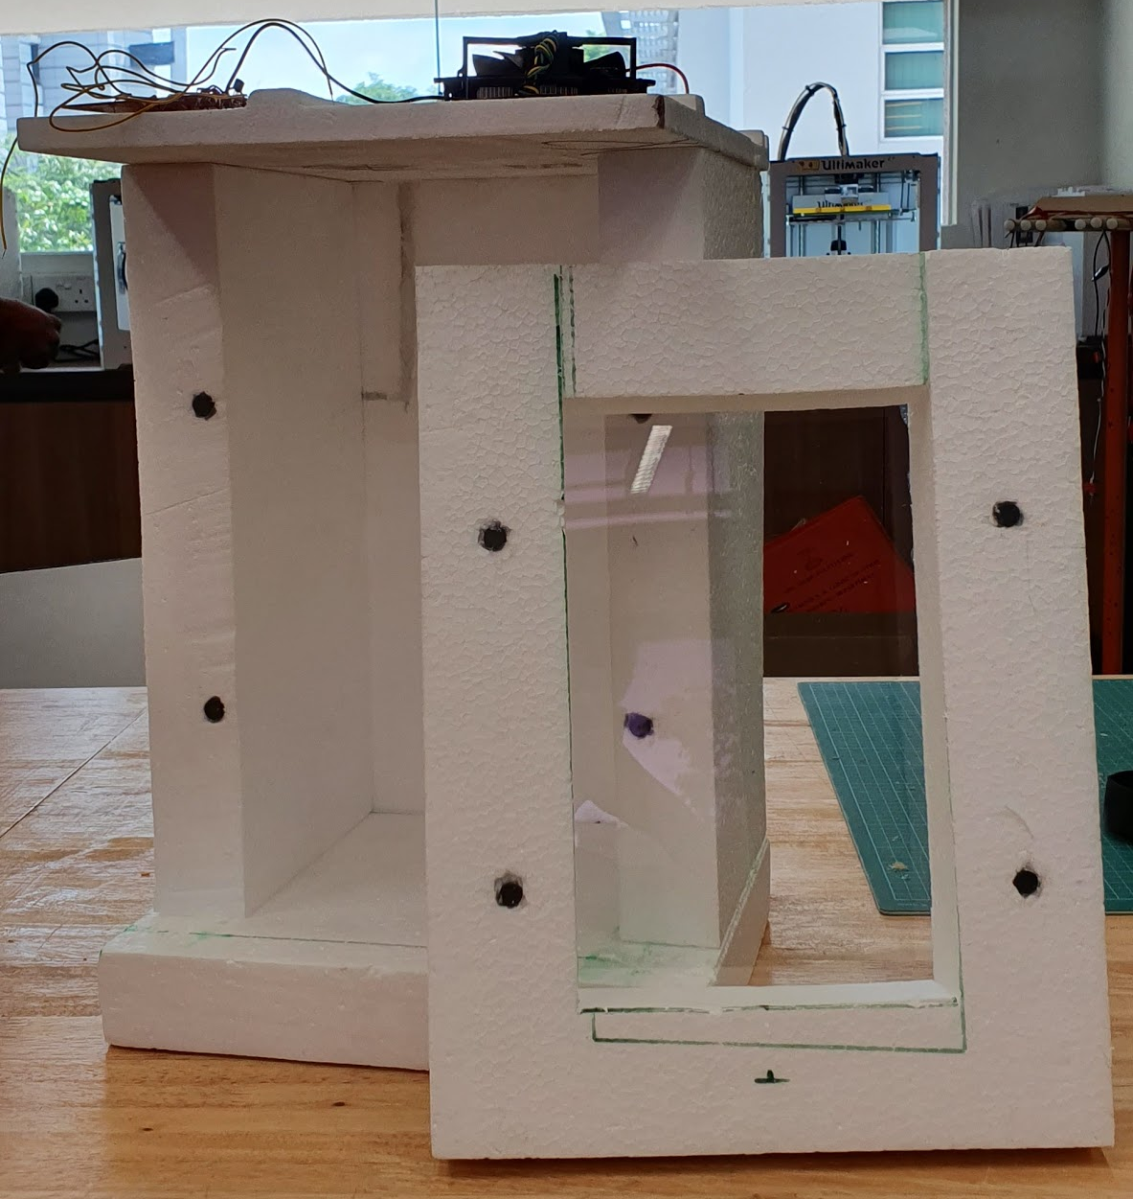
Peltier Unit
50mm Thick Styrofoam
CPU Fan
Heatsinks
Peltier
1 Ardunio

Slide 31
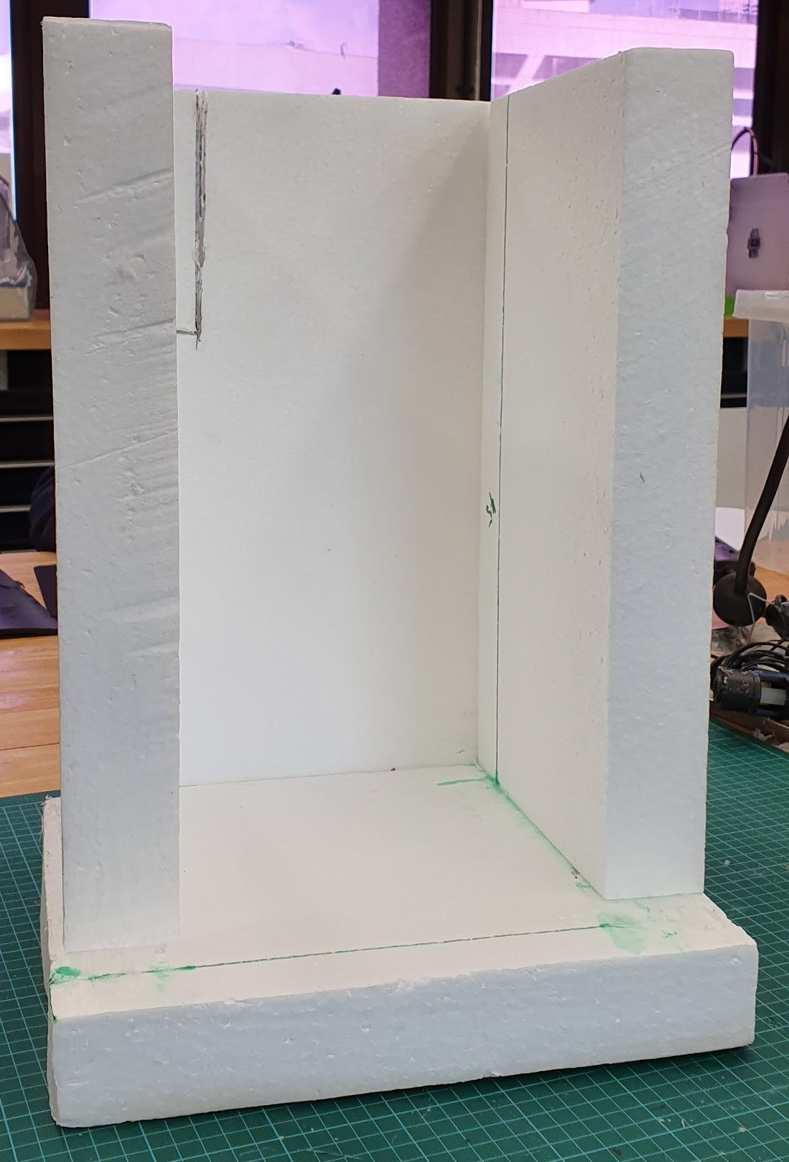
Insulation - 50mm thick styrofoam

Slide 32
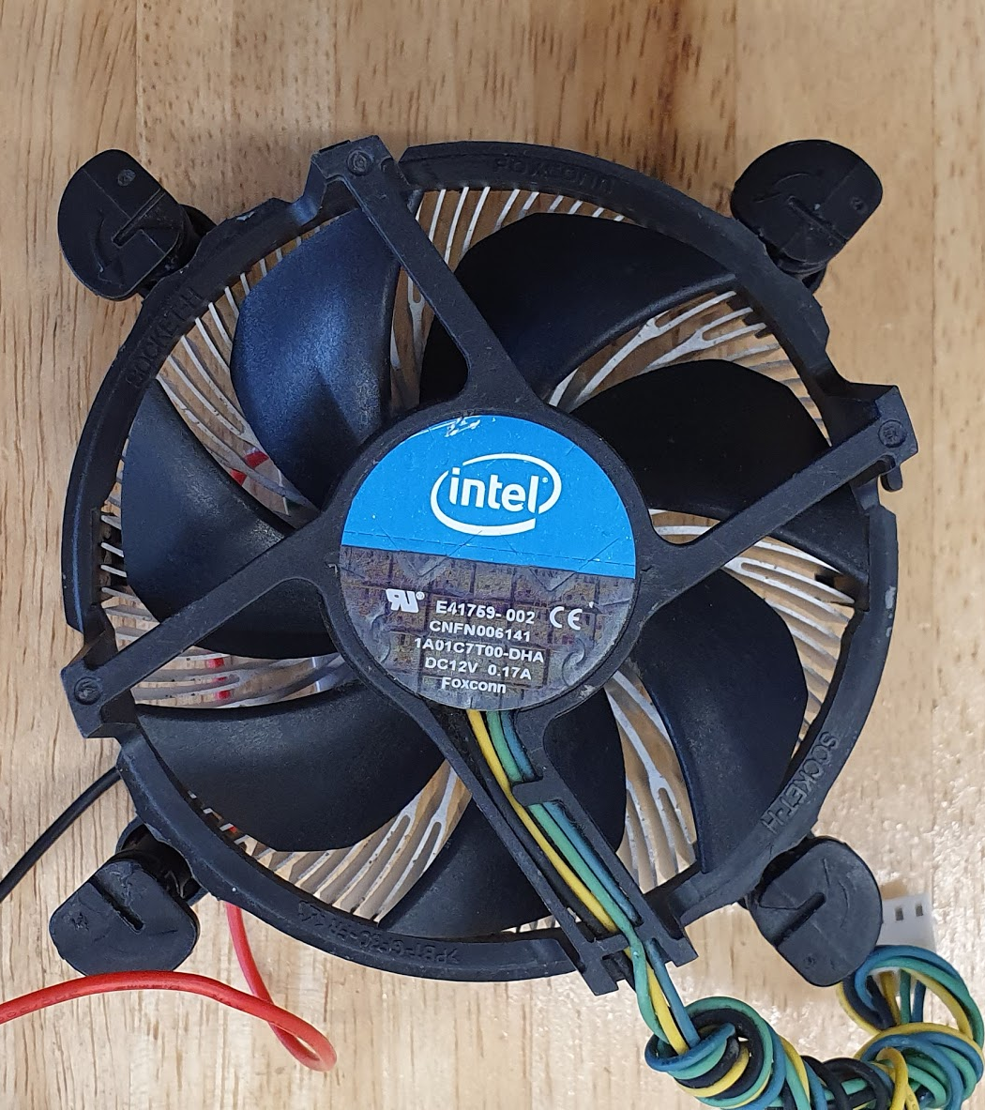
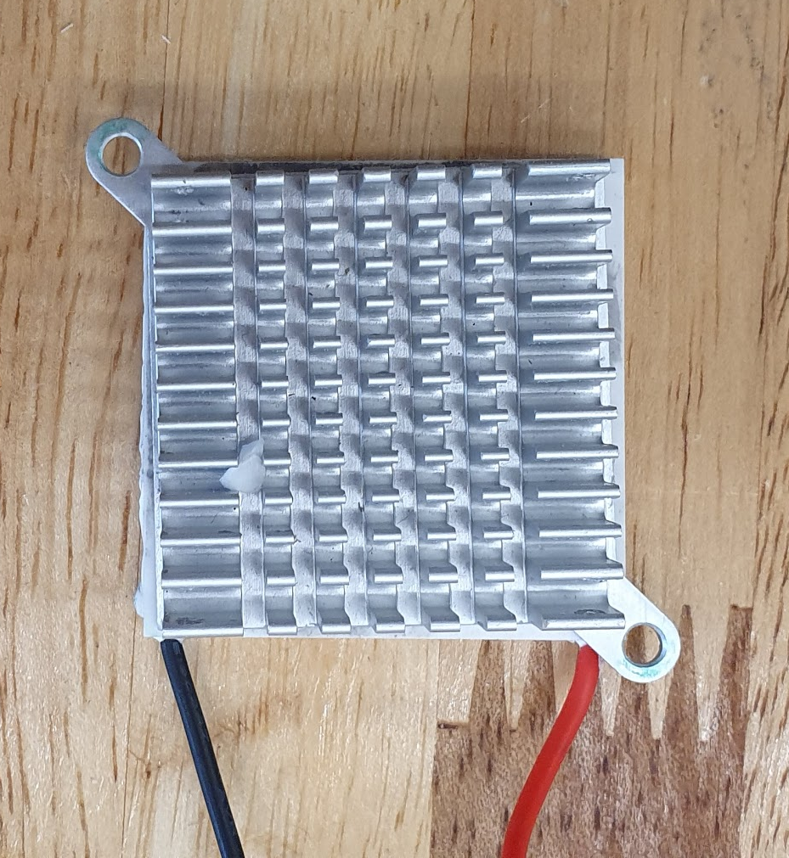
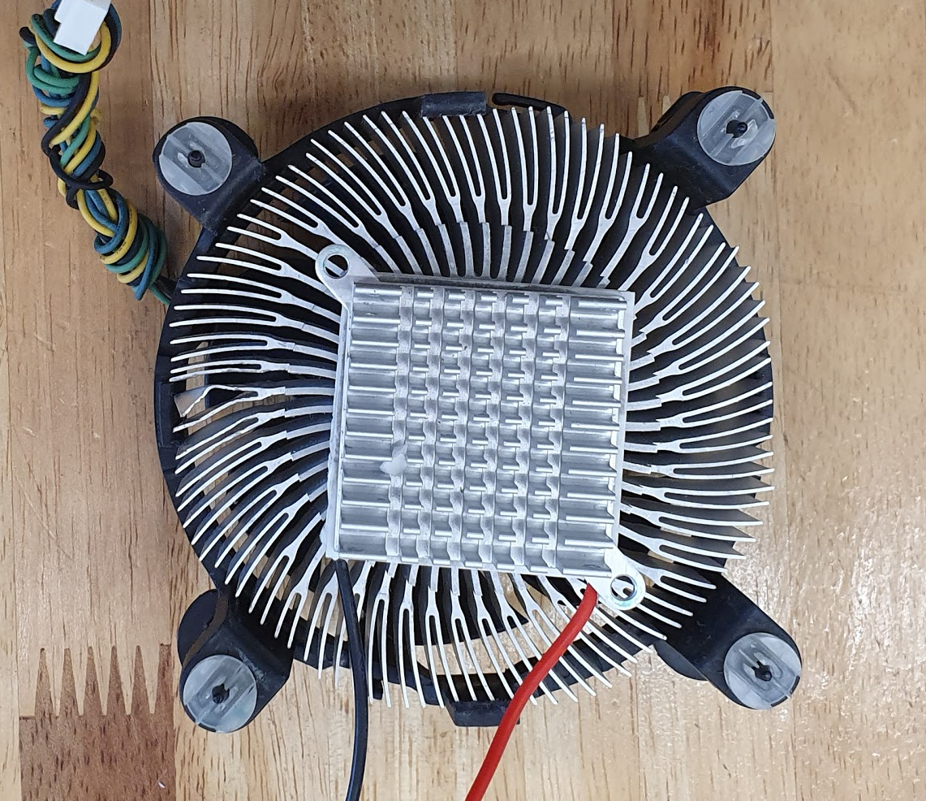
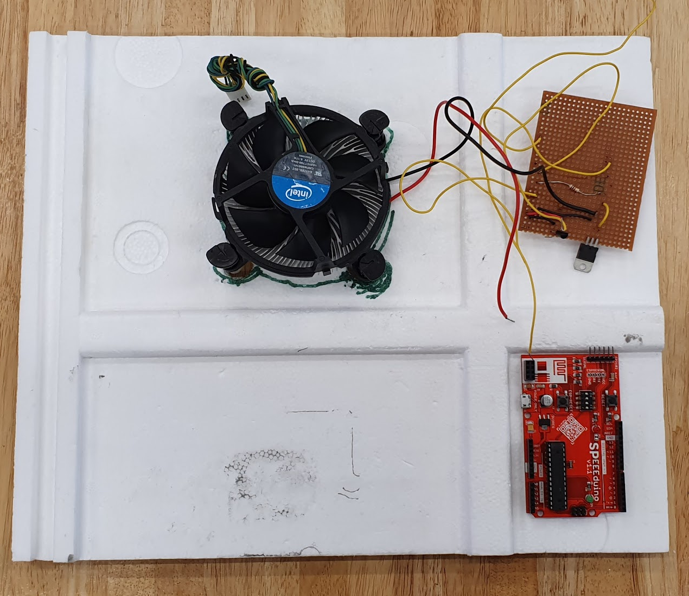
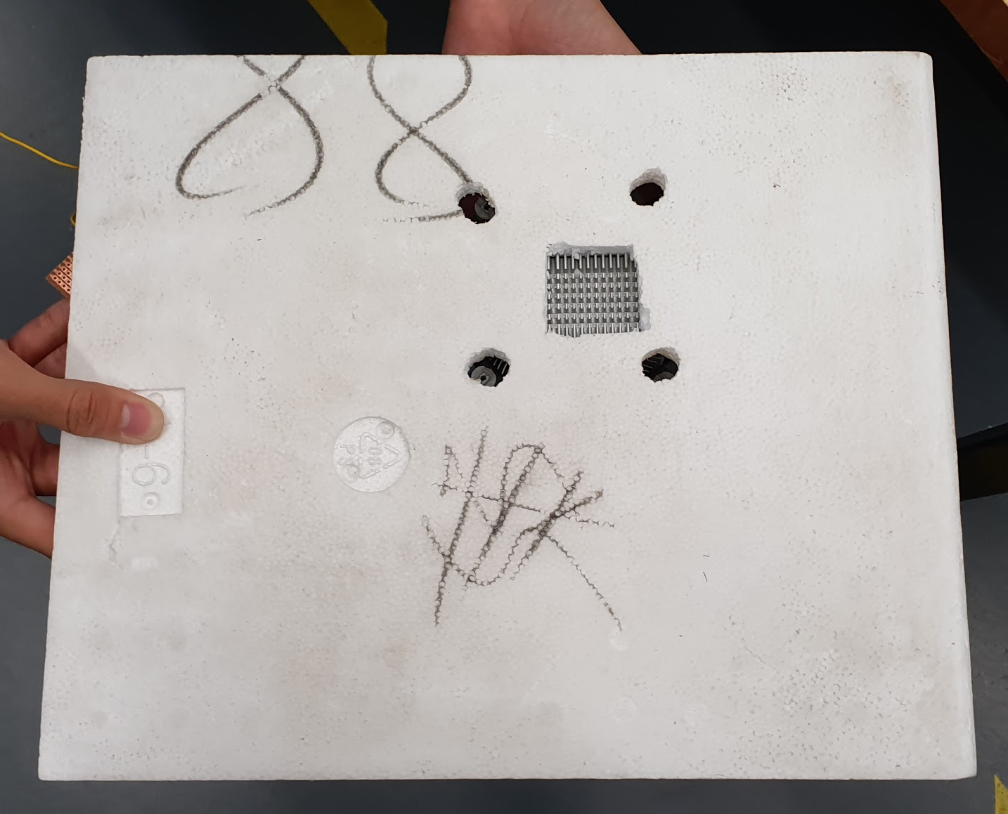
Cooling Unit

Slide 33
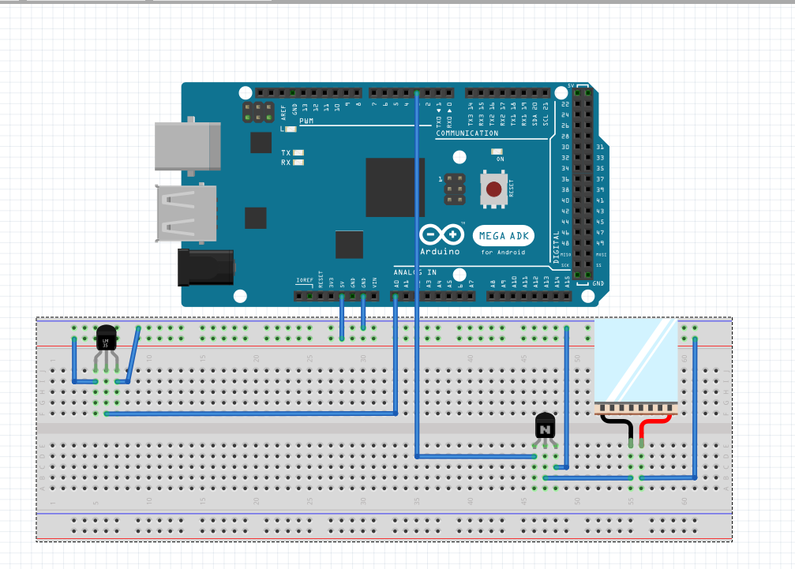
Schematics

Slide 34

Limitations

Slide 35
Limitations
3D Extruding Unit
Need to manually code the design of the extruded part
Basic shapes
Low Printing Capacity
Peltier Unit
Not Energy Efficient
Insufficient Insulation
Slow Freezing of Food Puree

Slide 36
Further Improvements
More energy efficient cooling unit
High Printing Capacity
Freedom of Printing (G-codes)
CNC shield
Food Grade Materials
IOT

Slide 37
Live Demonstration

Slide 38
Thank You
QnA

